Slide 1

Covid-19 research articles summarization
- Akshay Ladha

Slide 2
Background
Covid-19 has become an unavoidable topic
Understand more the impact of pandemic on the world
Previous project related to Covid-19

Slide 3
Why is it important?
Different phases of Covid-19 pandemic
The sentiment of people towards pandemic keeps changing
Lot of research articles published, and more keep coming
Common people need to stay updated with development of pandemic
Reading long articles is not practical

Slide 4
Data Source
Dataset has been obtained from https://ai2-semanticscholar-cord-19.s3-us-west-2.amazonaws.com/historical_releases.html
CORD-19 is a corpus of academic papers about COVID-19 and related coronavirus research.
CORD-19 is released weekly. Each version of the corpus is tagged with a date stamp (e.g., 2020-02-07)
First release: 2020-03-13 and Latest release: 2022-02-07

Slide 5
Dataset Features
Size of the dataset: 31.9 GB
The files in each version are:
• changelog
• cord_19_embeddings.tar.gz
• document_parses.tar.gz
• metadata.csv

Slide 6
Dataset Features contd..
Metadata.csv file contains values corresponding to full text JSON files
This JSON files contain, full text of article, title, author, abstract, etc.
I created a file with this articles in ArtcilesText.csv
Unit of analysis here will be articles

Slide 7
Dataset Features contd…
Number of Articles in original dataset is 338,451 and size is 31.9 GB
Created a dataset of 2500 articles as ArticlesText.csv with size 66.16 MB

Slide 8
Dataset Elements of Interest – ArticlesText.csv
Value | Type | Description
Source_x | String | Name of Source for the paper
Title | String | Paper title
doi | String | Paper DOI (paper identifier)
abstract | String | Paper abstract
authors | String | Authors of the paper
Pdf_json_file | String | Path to JSON file
body_text | String | Full text of the article

Slide 9
Research Questions
Can we get a Summary of the article without omitting important information?
1
Can clustering similar research articles together simplify the search for related publications?
2

Slide 10
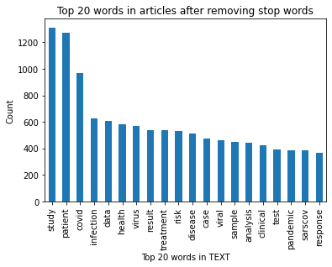
Initial EDA (v1.1) -
This are the top 20 words from all the articles and their count
Patient, Study, Covid dominates the articles with count more than 50,000

Slide 11
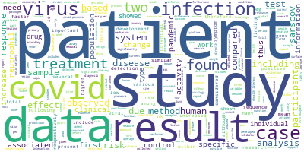
Initial EDA results
Word cloud shows most used words
The size and color of each word represents its frequency or importance
‘patient’ and ‘result’ are the most prominent words

Slide 12
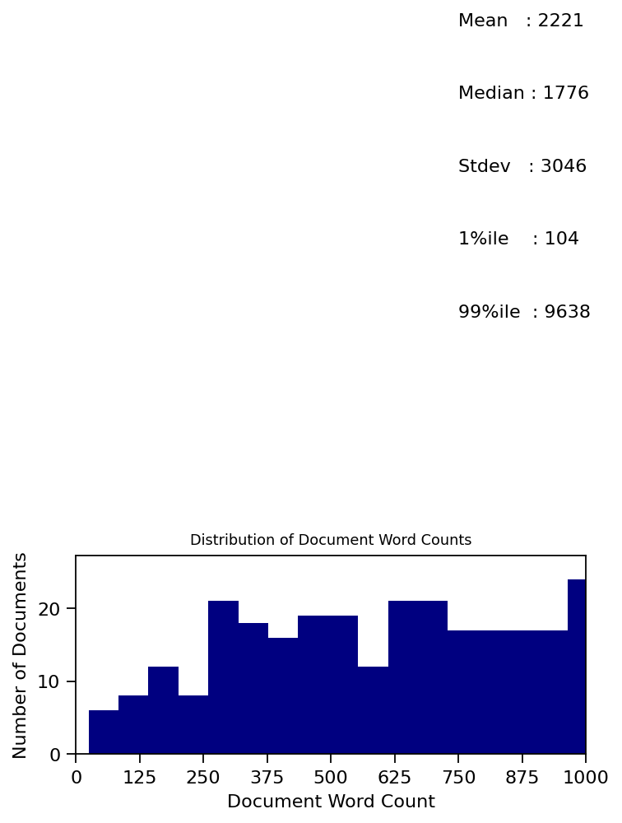
Distribution of Document Word Count
Descriptive statistics of word count of documents
Majority of documents have over 9,000 words
Average number of words are around 2,000

Slide 13
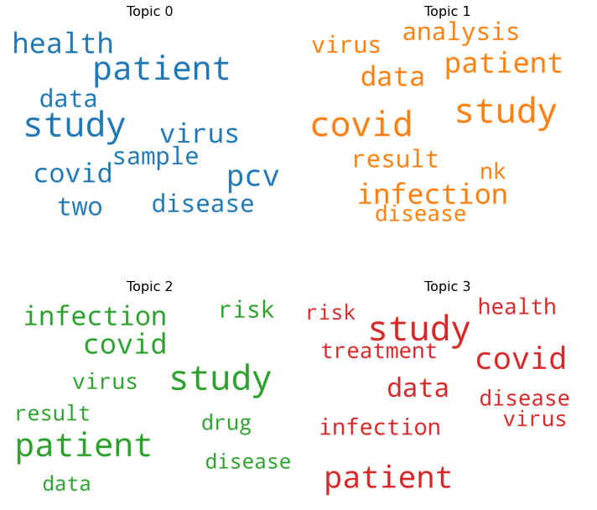
Word Cloud by Topic
Topic 0 talks more about patient, health, study
Topic 1 talks more about virus, analysis, covid and study

Slide 14
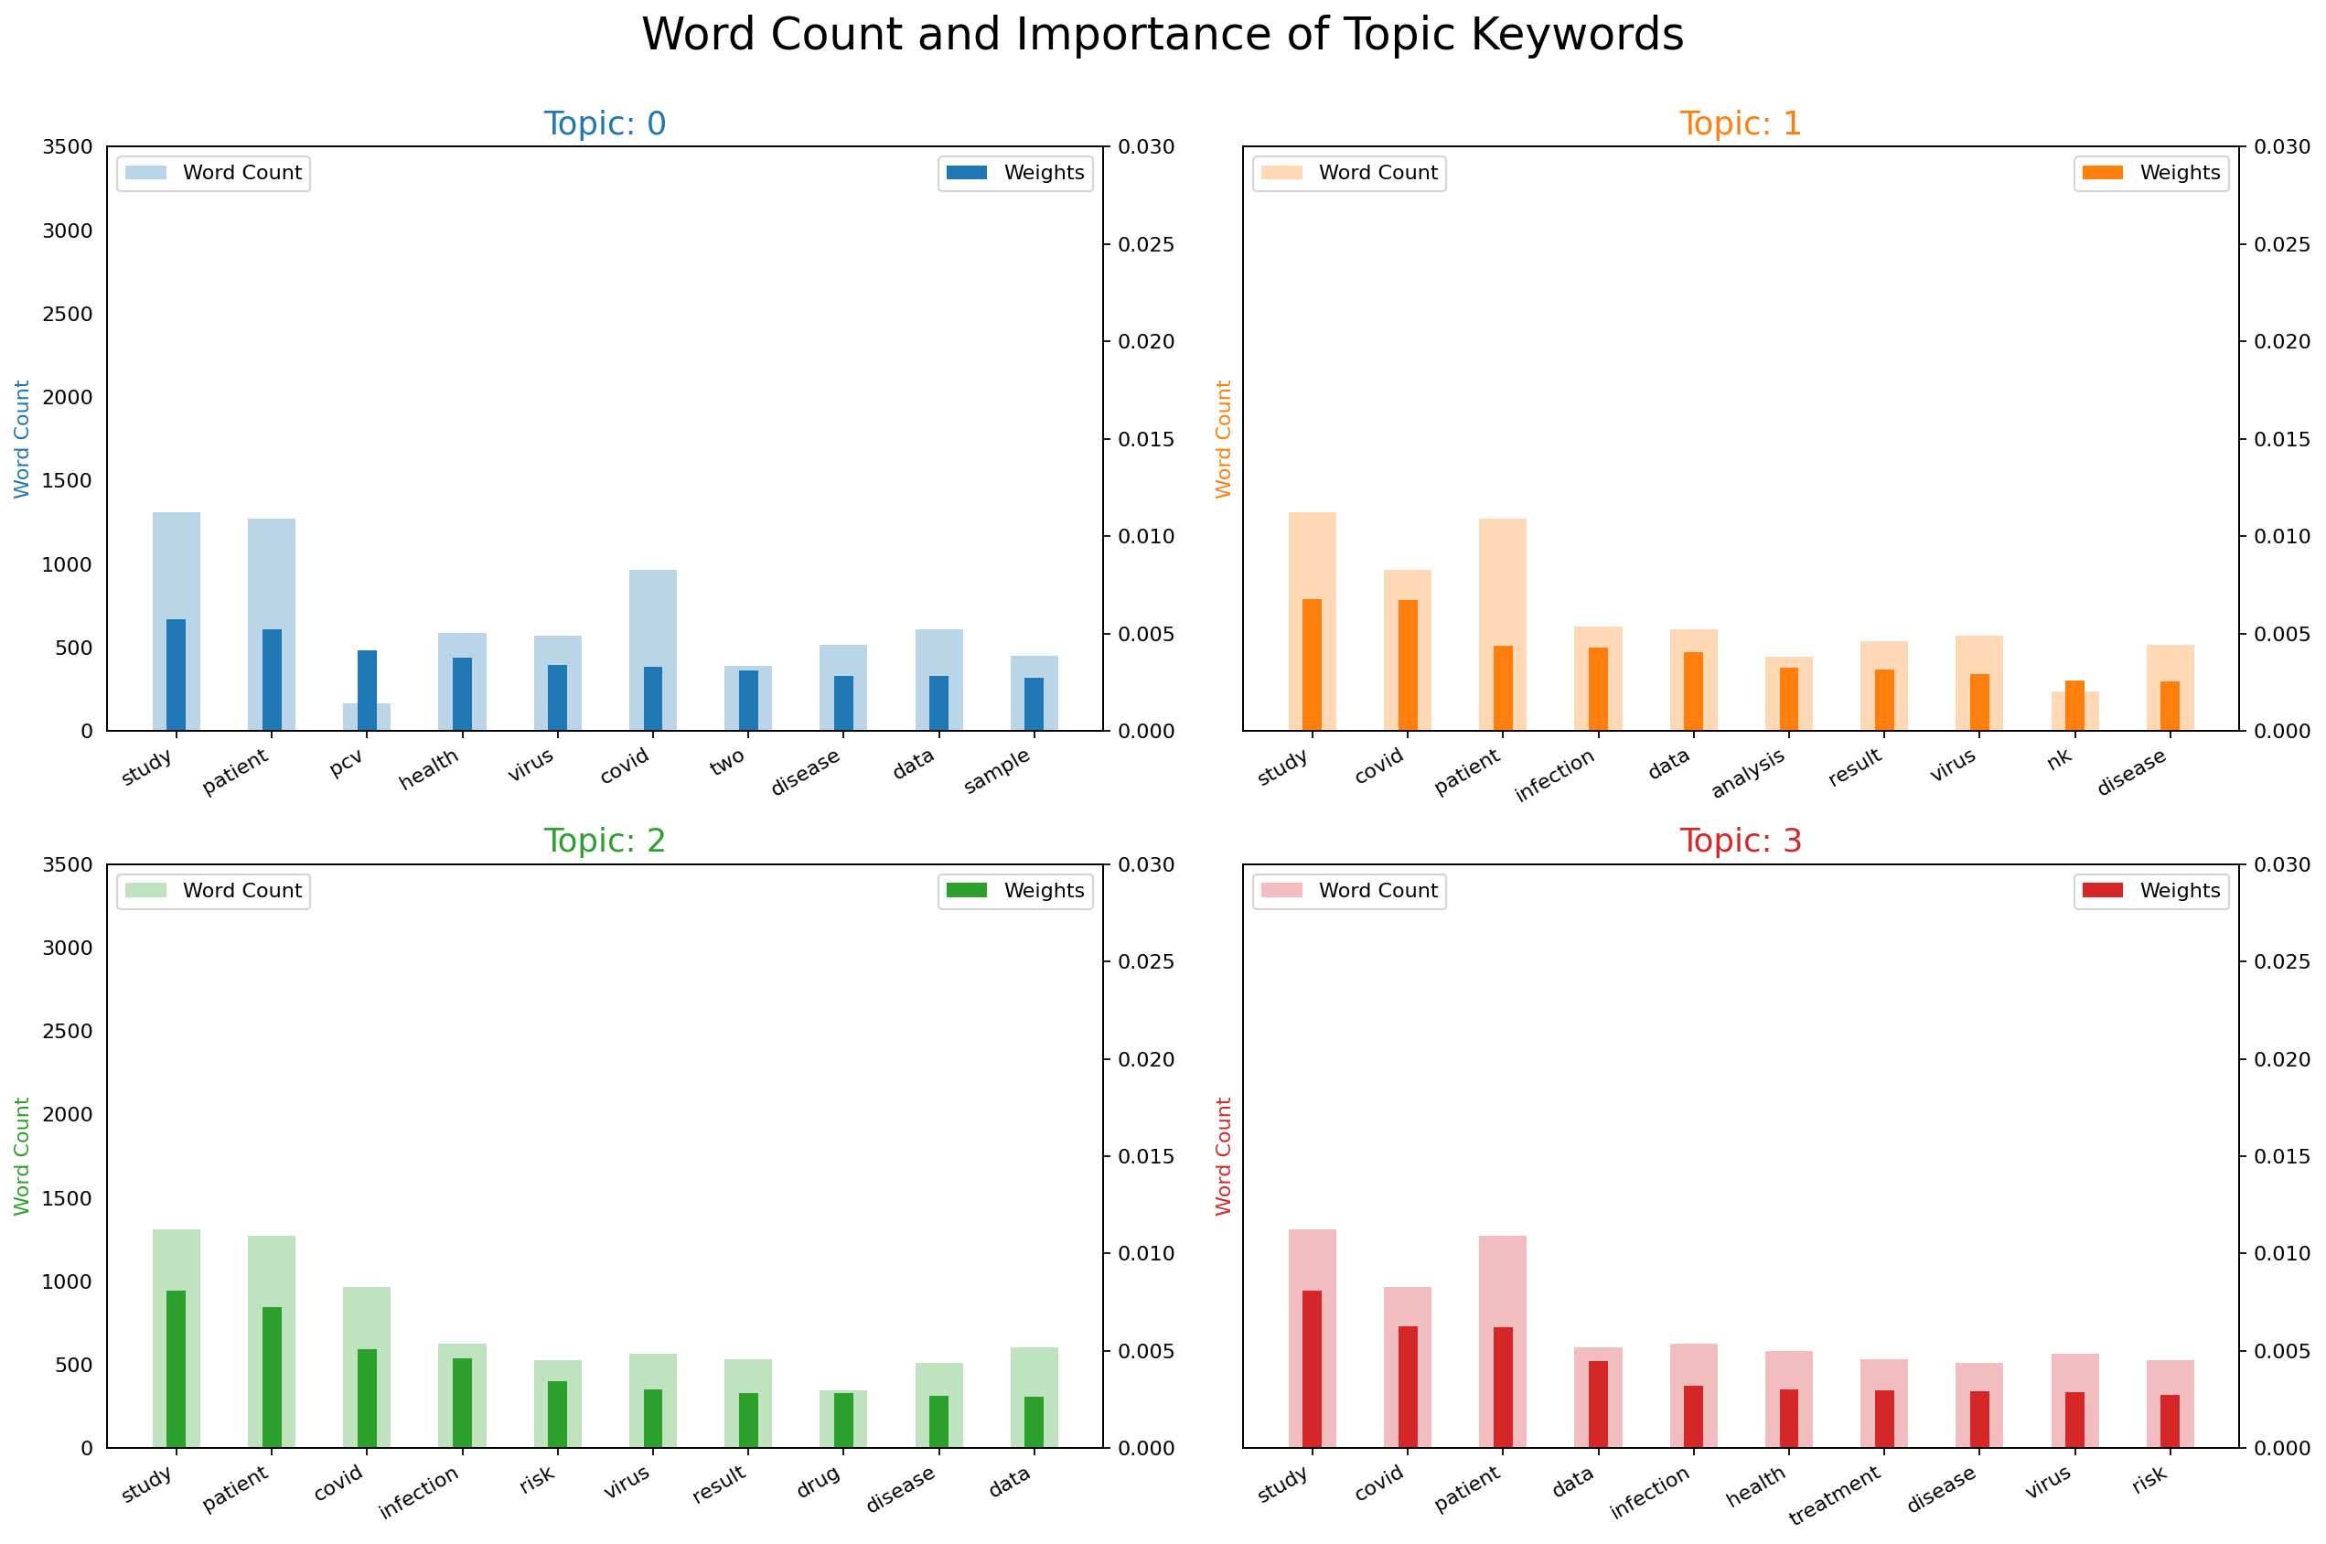
Importance of topic keywords
Patient, study, covid, data seem to be more dominant across the topics.

Slide 15
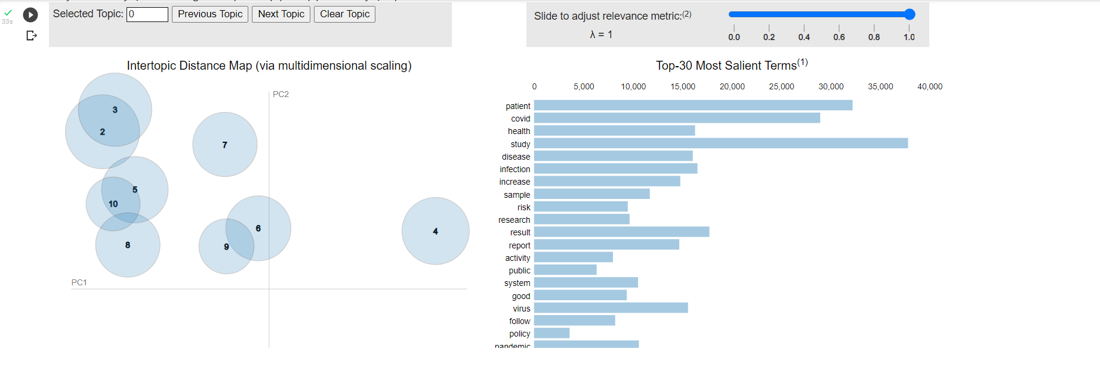
LDA

Slide 16
Next Step
Use T5 model to summarize
Classification

Slide 17
Classification
It is difficult for health professionals to keep up with new information on the virus
Can clustering similar research articles together simplify the search for related publications?
By using clustering for labelling in combination with dimensionality reduction for visualization, the collection of literature can be represented by a scatter plot.
On this plot, publications of highly similar topic will share a label and will be plotted near each other.

Slide 18
Approach for Classification
Choose randomly a subset of Dataset with 50,000 articles.
Data Pre-Processing.
Turn each document into a feature vector using TF-IDF.
Apply PCA.
Apply K-means clustering to label each cluster.
Dimensionality Reduction using t-SNE

Slide 19
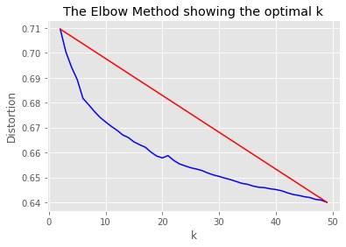
K-means Clustering
To find the best k value for k-means we'll look at the distortion at different k values.

Slide 20
Dimensionality Reduction with t-SNE
t-Distributed Stochastic Neighbor Embedding (t-SNE) is a technique for dimensionality reduction that is particularly well suited for the visualization of high-dimensional datasets.
Using t-SNE we can reduce our high dimensional features vector to 2 dimensions.
By using the 2 dimensions as x,y coordinates, the body_text can be plotted.

Slide 21
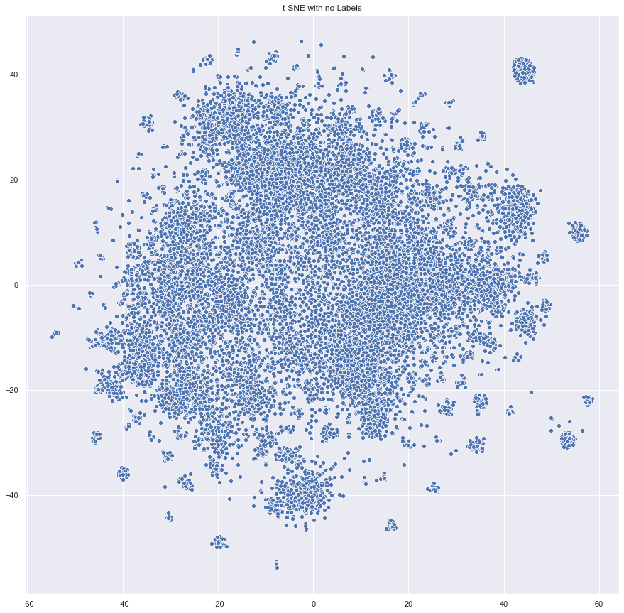
t-SNE results
Many instances closer to the center are harder to separate.
Use the clusters found by k-means as labels.

Slide 22
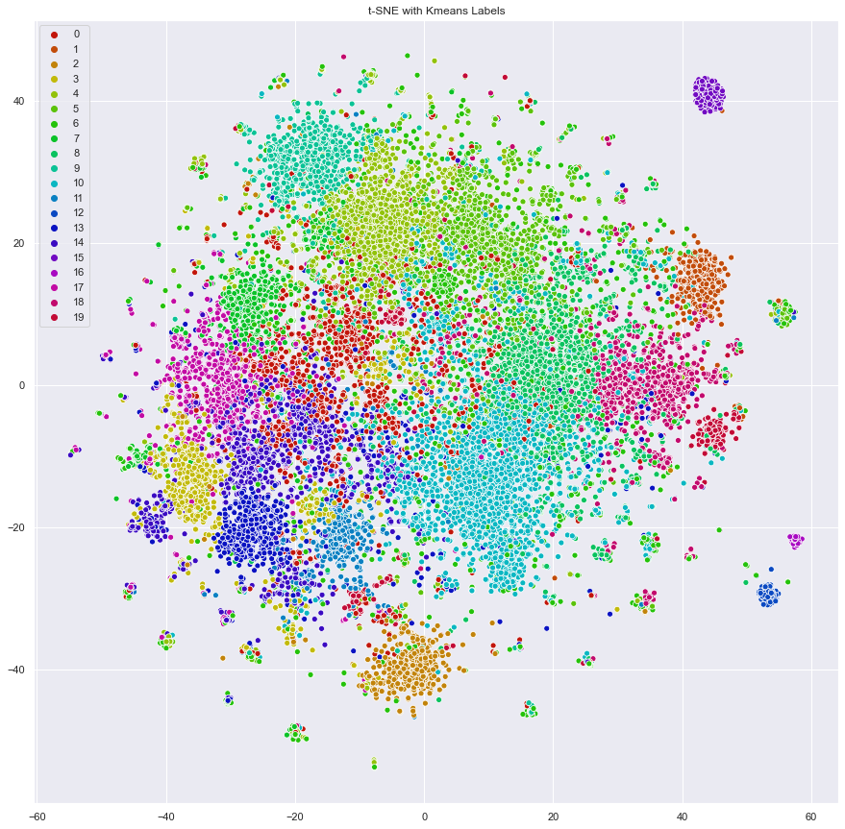
t-SNE with K-means
The location of each paper on the plot was determined by t-SNE while the label (color) was determined by k-means.

Slide 23
Model Build
Implement Transformer based models for Article Summarization.
A Transformer is an attention mechanism that learns contextual relations between words or sub-words in a text.
A Transformer includes two separate mechanisms – An Encoder system that reads the input text and a Decoder system that produces a prediction for the task.
Use T5 Transformer model

Slide 24

T5 Transformer model
T5 transformer is a text-to-text transformer model. The architecture in the framework is encoder-decoder
The model is first pretrained unsupervised on a large corpus before supervised training with input text representing all these tasks and the associated labelled data which is also text
We load the t5-base pretrained model from Hugging face's repository. Then we can fine-tune it using the transformers, Trainer API.

Slide 25
Evaluation of T5 Transformer
METRIC | F-SCORE | P-SCORE | R-SCORE
ROUGE-1 | 0.19 | 0.43 | 0.12
ROUGE-2 | 0.05 | 0.14 | 0.03
ROUGE-L | 0.17 | 0.40 | 0.11

Slide 26
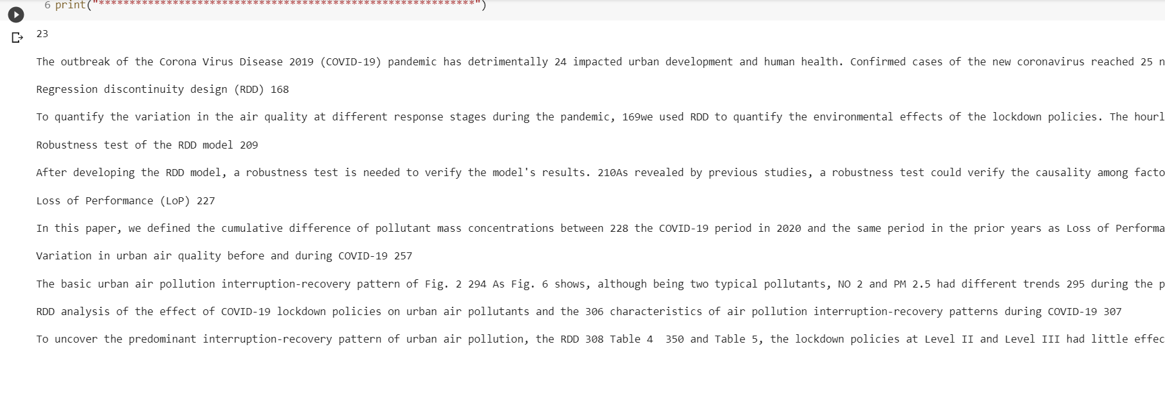
T5 transformer model result
Full Text

Slide 27
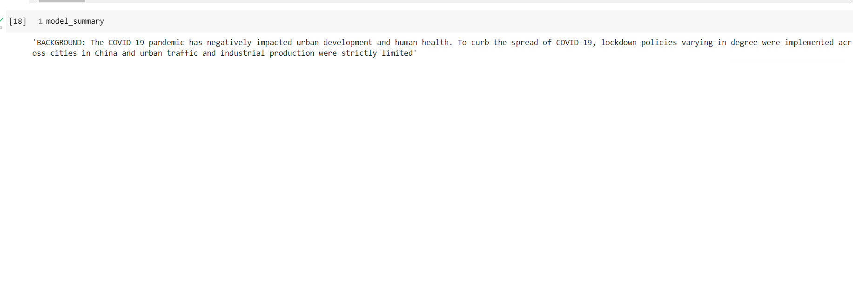
Summary

Slide 28
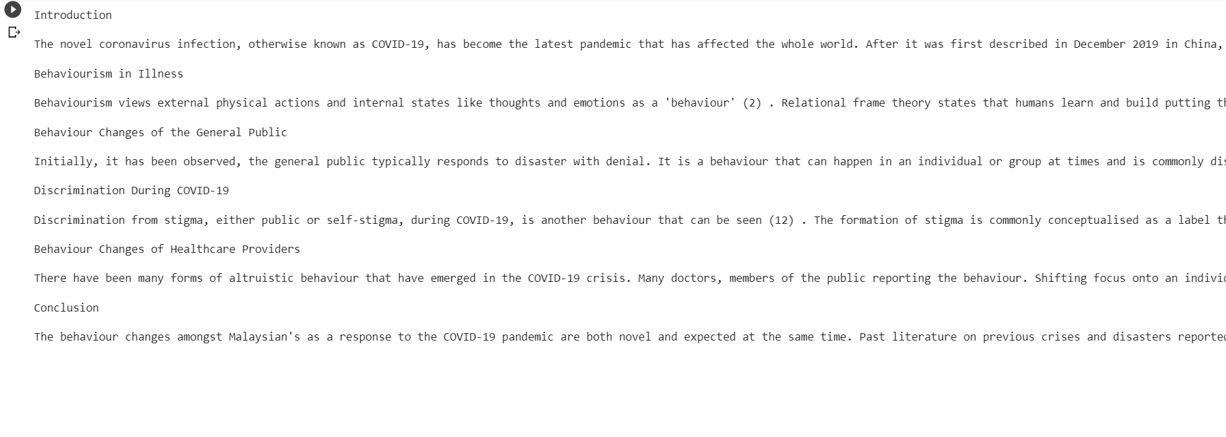
Second Example

Slide 29
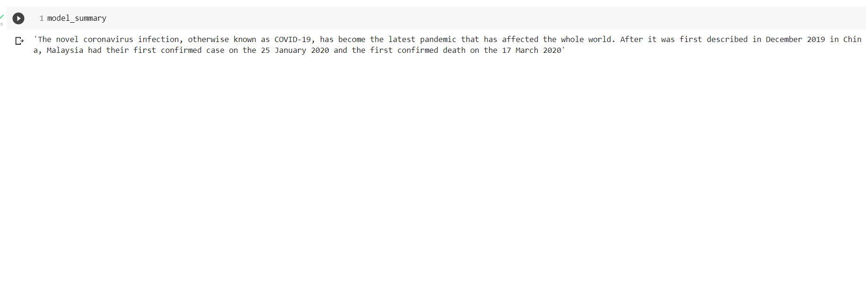
Summary of Second Example

Slide 30
Conclusion
K-means (represented by colors) and t-SNE (represented by points) were able to independently find clusters, showing that relationships between papers can be identified and measured.
Papers written on highly similar topics are typically near each other on the plot and bear the same k-means label.
We have implemented transfer learning T5 model to generate abstractive summaries for the research articles.

Slide 31
Future Work
As k-means simply split the data into clusters, topic modeling through LDA can be performed to identify keywords.
A more interactive plot can be designed to allow professionals to quickly find material related to a topic.
Use more models for Text Summarization and compare with T5 model to find the most efficient model for summarization and use other metrics such as Bleu to evaluate performance.

Slide 32

THANK YOU!

Slide 33
References
https://github.com/allenai/cord19
https://ai2-semanticscholar-cord-19.s3-us-west-2.amazonaws.com/historical_releases.html
http://cs230.stanford.edu/projects_spring_2020/reports/38954132.pdf
https://medium.com/swlh/text-summarization-guide-exploratory-data-analysis-on-text-data-4e22ce2dd6ad
https://medium.com/@nqabell89/visualizing-unsupervised-text-classification-output-with-pyldavis-370c1784ed58

Slide 34
References contd…
https://github.com/ageron/handson-ml2
https://github.com/SoloNick/arXiv-Literature-Clustering/blob/master/arxiv_clustering.ipynb
https://towardsdatascience.com/introduction-to-text-summarization-with-rouge-scores-84140c64b471
https://towardsdatascience.com/end-to-end-topic-modeling-in-python-latent-dirichlet-allocation-lda-35ce4ed6b3e0

